Slide 1
Local Storage
BYU-I CIT 261
Ryan Dockstader

Slide 2
What is Local Storage?
Local Storage allows you to store information that relates to your page, long term.
Similar to session storage, but this data will persist past the browser session
This data never expires, and will last until it is cleared by the user or by the page

Slide 3
Why Use Local Storage?
Local storage should be used anytime you want information to persist longer then a browser session, but shorter then database storage.
A common usage for local storage is the “remember me” check mark that is frequently found on login pages

Slide 4
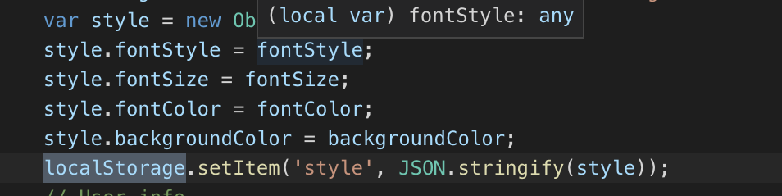
How To Use Local Storage – Save data

Slide 5
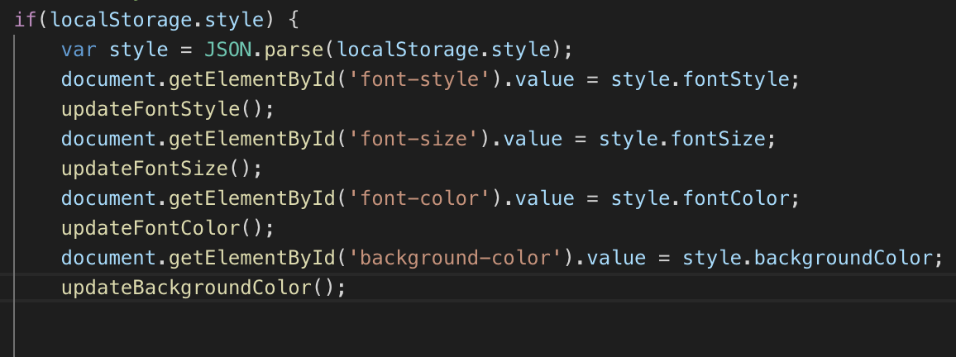
How to Use Local Storage – Load Data

Slide 6
References
https://developer.mozilla.org/en-US/docs/Web/API/Window/localStorage
https://www.w3schools.com/jsref/prop_win_localstorage.asp

